Slide 1
Breadth-First Search
Zhicheng Gu 10/08/16

Slide 2
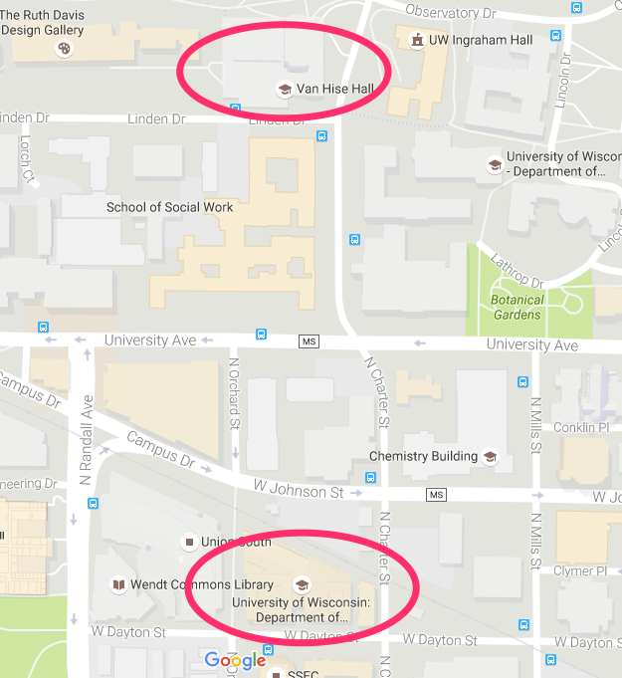

Slide 3
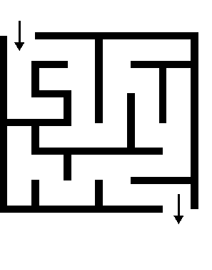
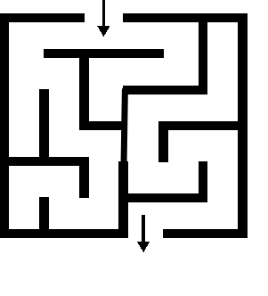
Search
Find a path from one place to another place.

Slide 4


Slide 5
Breadth-First Search (BFS)
Breadth-first search (BFS) is a search algorithm which starts from the first place and explores the neighbor places first. Then move to the next level neighbors.

Slide 6
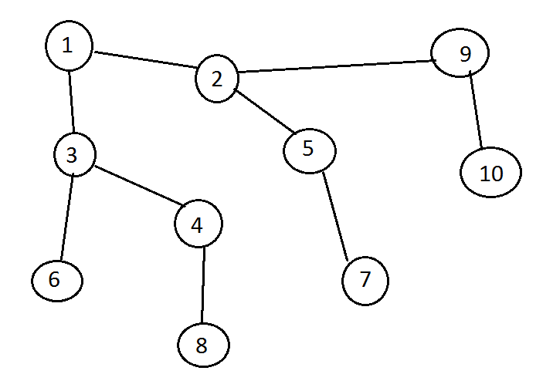
Breadth-First Search (BFS)

Slide 7
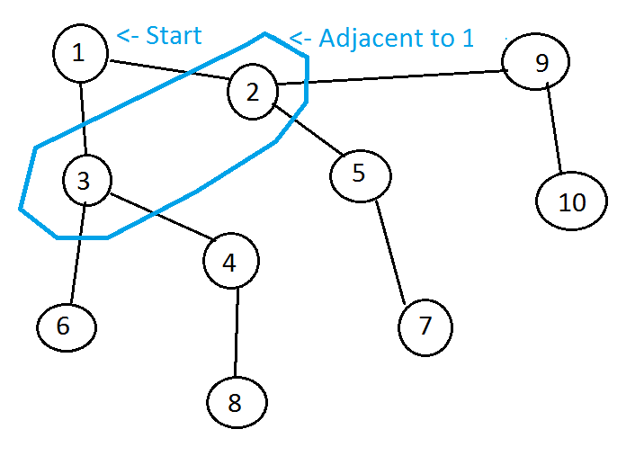
Breadth-First Search (BFS)

Slide 8
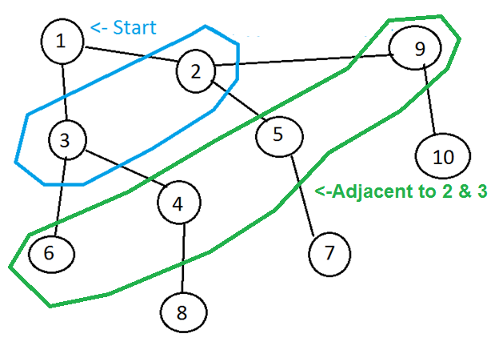
Breadth-First Search (BFS)

Slide 9
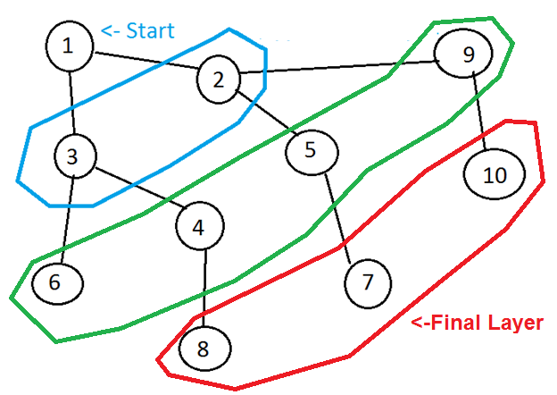
Breadth-First Search (BFS)

Slide 10
